Slide 1
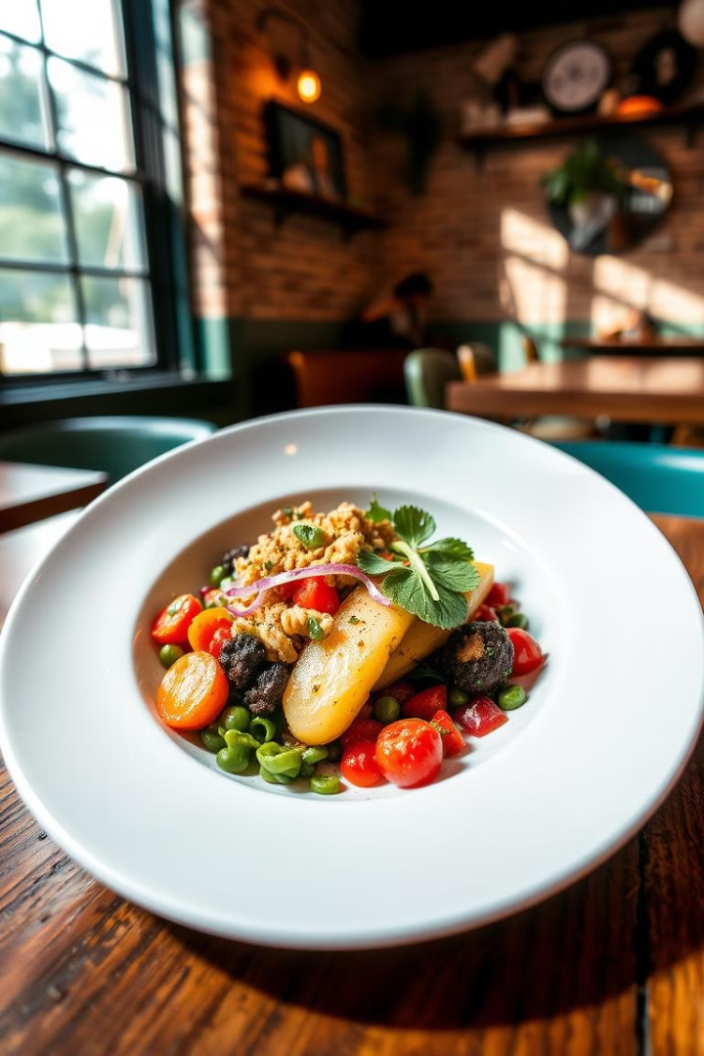
Curefoods YouTube Content Strategy
A comprehensive plan to grow Curefoods' YouTube channel and engage viewers.
by Mohan S

Slide 2
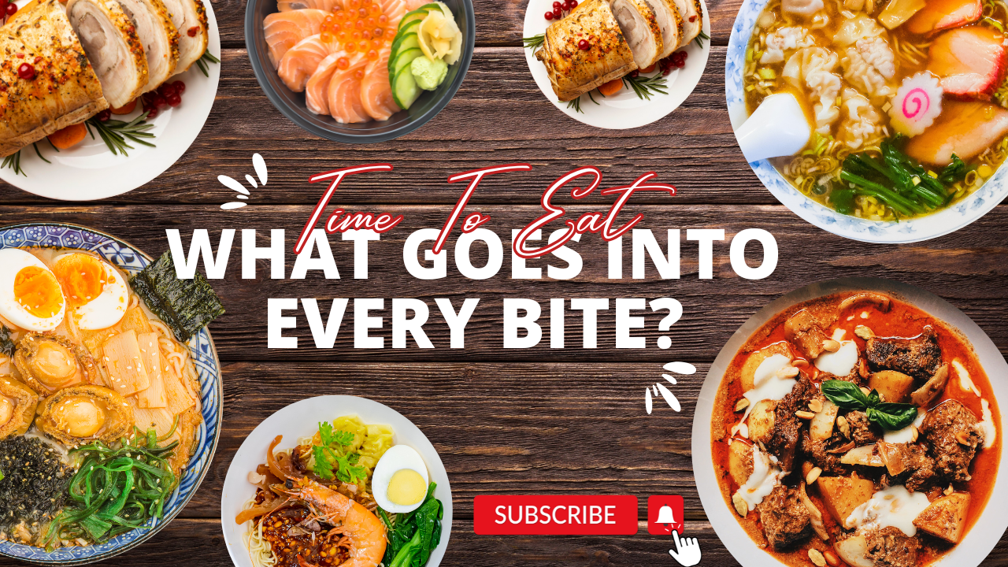
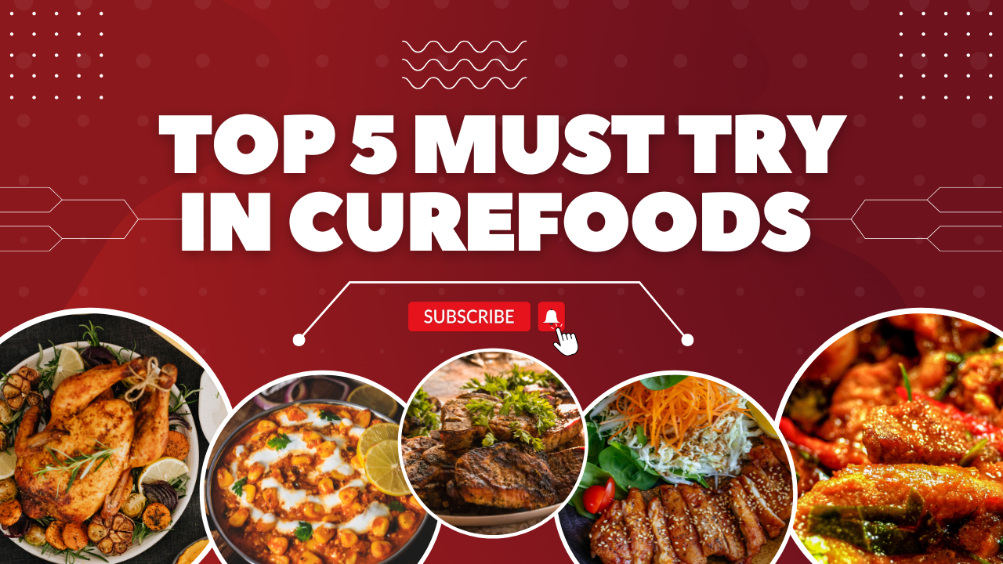
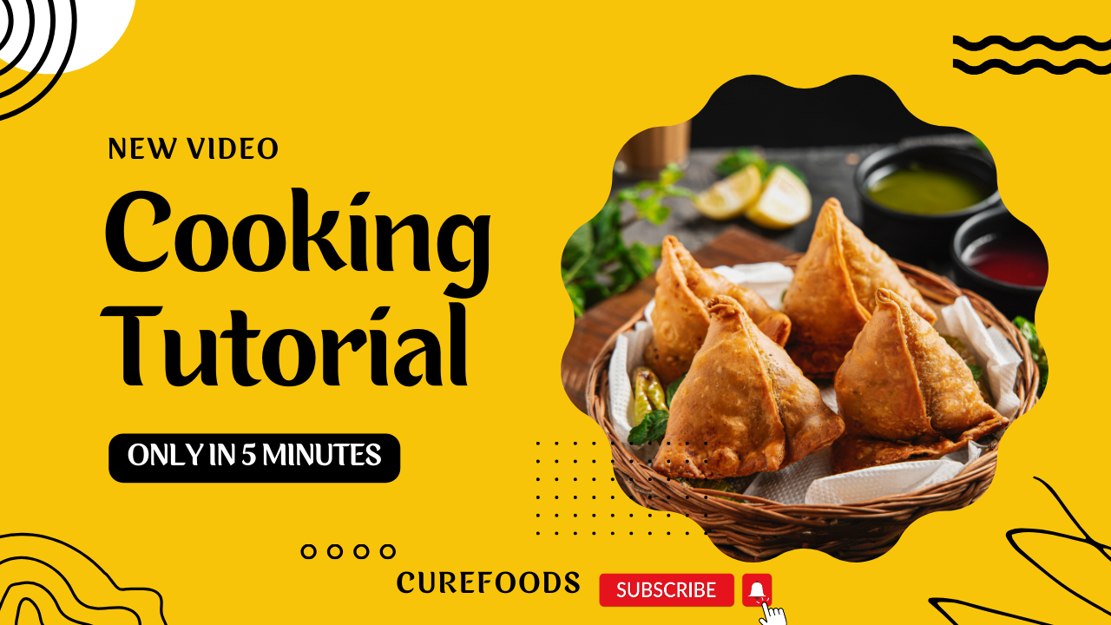
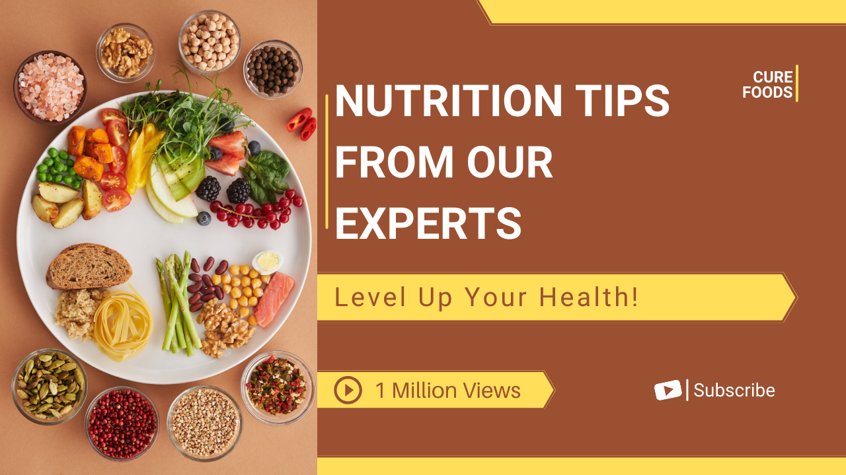
1
2
Title: What’s Behind Every Delicious Bite? 🍜🍣 A Food Lover’s Journey! 🍴
Title: Top 5 Dishes You MUST Try at CureFoods! 🍗🔥 Unmissable Delights Await!
3
4
Title: 5-Minute Samosa Recipe! 🥟 Quick & Easy Cooking Tutorial by CureFoods
Title: Expert Nutrition Tips to Transform Your Health 🍎🌱 Boost Your Energy and Wellness Today!

Slide 3
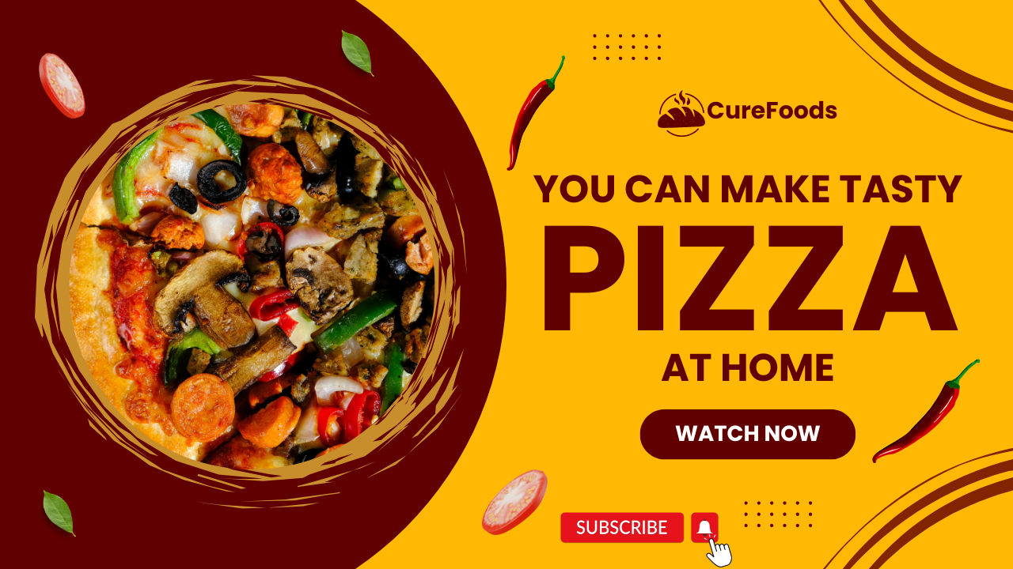
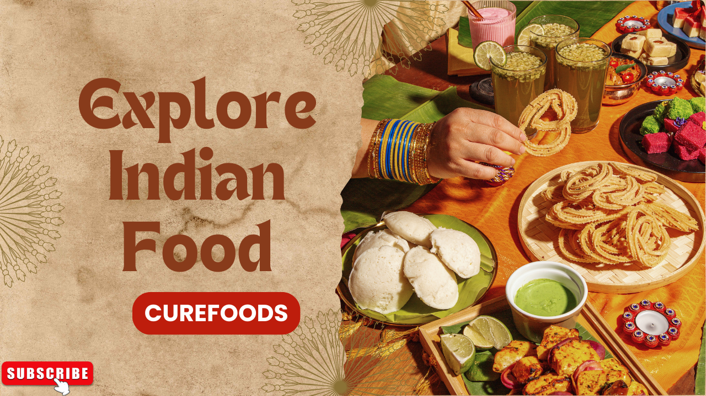
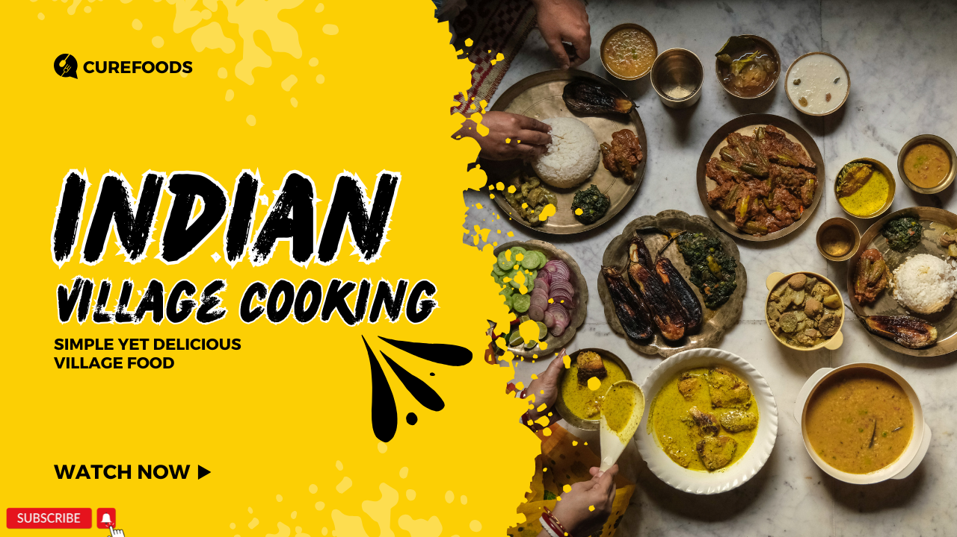
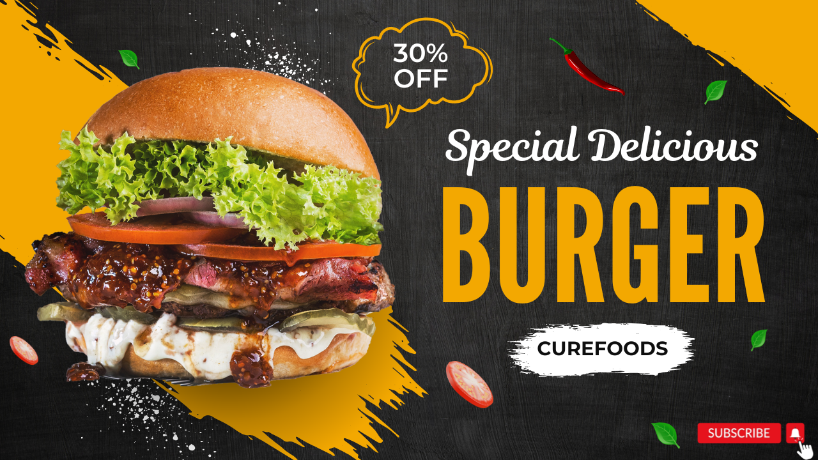
5
6
Title: Make Delicious Pizza at Home! 🍕 Easy Recipe & Pro Tips | CureFoods
Title: Discover the Flavors of India 🇮🇳 A Culinary Journey with CureFoods!
7
8
Title: Authentic Indian Village Cooking 🍛 Simple & Delicious Recipes to Warm Your Heart
Title: Juicy & Irresistible! 🍔 Special Burger Recipe | 30% OFF at CureFoods

Slide 4
Content Pillars: Variety & Focus
Global Cuisines
Behind the Scenes
Quick & Easy Recipes
Health & Nutrition
Explore diverse dishes and cultural significance.
Show the process, ingredients, and effort.
Time-saving tutorials for home cooks.
Expert advice and healthy meal ideas.

Slide 5
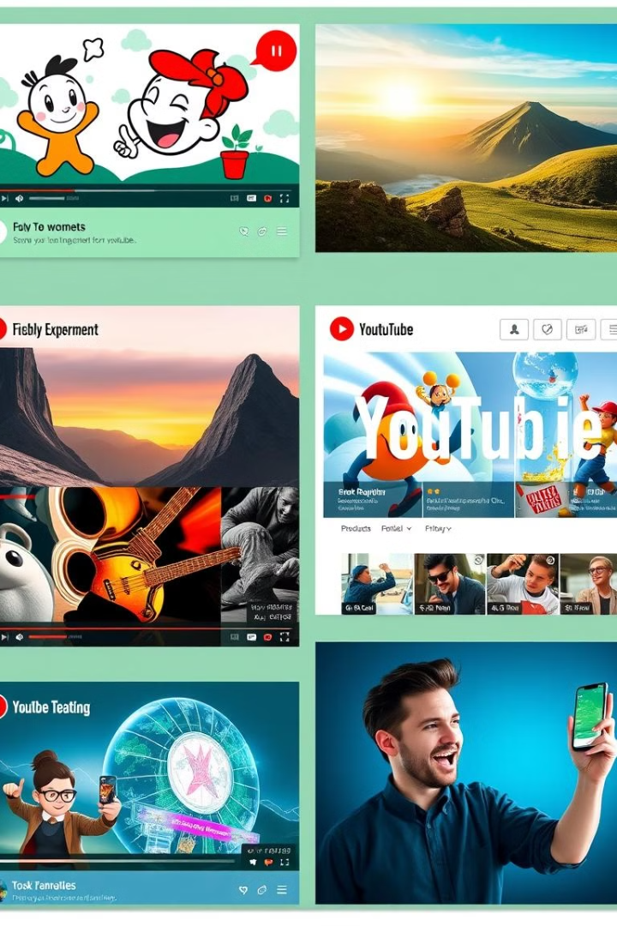
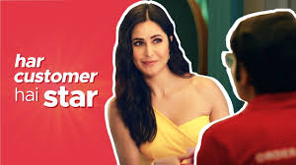
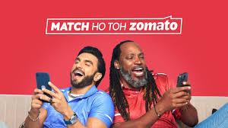
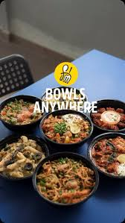


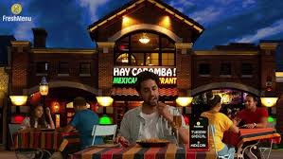
Competitor Analysis: Learning from the Best
Zomato
Swiggy
Fun, short videos, trending topics, influencer collaborations.
Storytelling, customer journeys, delivery experiences.
FreshMenu
Detailed recipes, health focus, gourmet meals.

Slide 6
Content Calendar: Strategic Timing
January 5
1
Story-driven content, New Year resolutions.
2
January 15
Listicle-style content, returning to routines.
January 25
3
Time-saving recipes, post-holiday solutions.
4
February 1
Health-related content, fitness resolutions.
February 14
5
Valentine's Day special, romantic or family activity.
6
March 1
Cultural food theme, Holi celebrations.
March 15
7
Rustic recipes, spring season, nostalgia.
8
March 29
Promotional offer, boost engagement, drive sales.

Slide 7
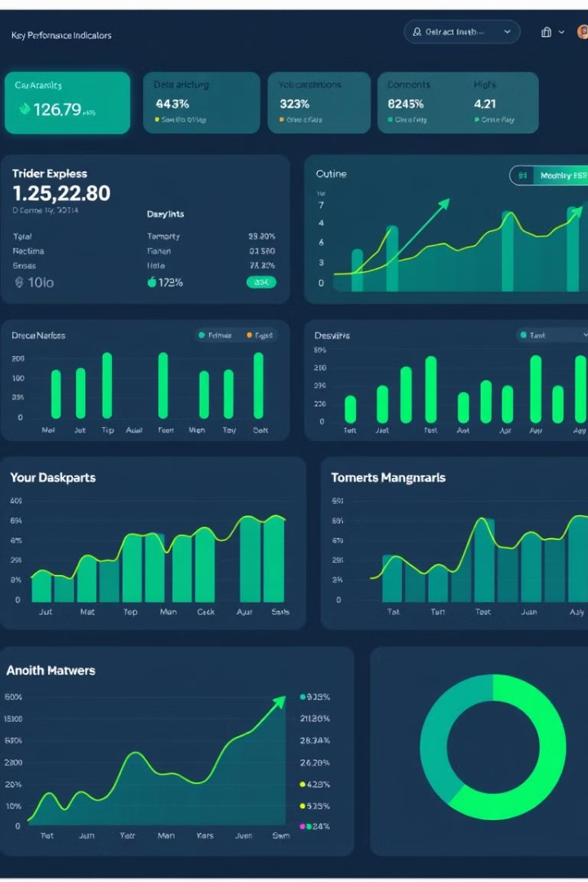




Performance Measurement: Tracking Success
Views
Watch Time
Measure overall reach and popularity.
Analyze viewer engagement and drop-off points.
Engagement
Conversions
Track likes, comments, and shares for audience interest.
Measure sign-ups, purchases, and ROI.

Slide 8





Strategy Adjustment: Optimizing for Growth
Content Optimization
1
Identify engaging themes, adjust video length.
2
Engagement Boost
Improve call-to-action statements, build community.
3
Promotion Strategy
Invest in paid promotion or influencer collaborations.
4
Testing & Experimentation
Change thumbnails, titles, and descriptions.
5
Data-Driven Decisions
Continuously analyze trends and patterns, allocate resources.

Slide 9
Key Takeaways: A Recipe for Success
Engaging Content
1
Intriguing titles, clear value proposition, relevant keywords.
Diverse Content Pillars
2
Global cuisines, behind the scenes, quick recipes, health tips.
Strategic Timing
3
Align content with relevant events and seasons.
Data-Driven Optimization
4
Track performance, identify trends, adjust strategy.

Slide 10

Next Steps: Actionable Plan
1
2
Finalize Content Calendar
Develop Video Scripts
Write engaging and informative scripts for each video.
Schedule video releases and align with marketing campaigns.
3
4
Create Video Assets
Implement Tracking & Analysis
Film, edit, and produce high-quality videos.
Monitor key metrics and adjust strategy based on data.

